Slide 1
Week 11 – Data Definition
AACS2192 Analysis and Design of IS – Case Study
Library System

Slide 2
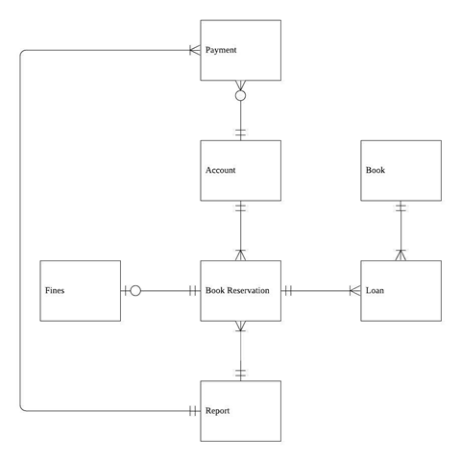
ERD

Slide 3
Attributes and Keys
Account (account_no, first_name, last_name, email, password, identity, date_Joined, fine_due)
Book Reservation (reserve_no, reserve_date, account_no*, report_no*)
Loan (reserve_no*, book_id*, collection_date, return_date)
Book (book_id, book_title, language, author, publisher, isbn, publish_year)
Fines (fine_no, day_count, fine_amount, reserve_no*)
Payment (payment_no, amount, payment_method, payment_date, account_no*, report_no*)
Report (report_no, date_created)

Slide 4
Codes
Account (account_no, first_name, last_name, email, password, identity, date_Joined, fine_due)
Type of Codes : Sequence Codes
e.g. account_no = 000001
Numbers assigned in a specific order
000001 -> 1st entry of the data

Slide 5
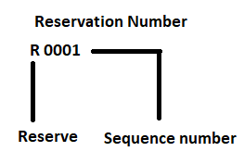
Codes
Book Reservation (reserve_no, reserve_date, account_no*, report_no*)
Type of Codes: Sequence Codes
The ‘R’ letter is at front of all reservation number to show it is a reservation.
Numbers assigned in a specific order
R0001 -> 1st entry of the data

Slide 6
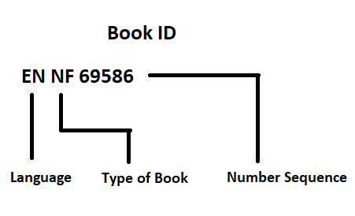
Codes
Book (book_id, book_title, language, author, publisher, isbn, publish_year)
Type of Codes: Significant Alphabetic Codes
Language | Type of Book | Number Sequence
EN- English ZH- Chinese ES- Spanish FR- French KO- Korean JP- Japanese MS- Malay TA- Tamil | NF- Non-Fiction F- Fiction | 5 system generated numbers

Slide 7
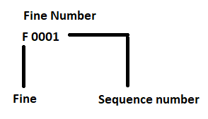
Codes
Fines (fine_no, day_count, fine_amount, reserve_no*)
Type of Codes: Sequence Codes
The ‘F’ letter is at front of all reservation number to show it is a fine number.
Numbers assigned in a specific order
F0001 -> 1st entry of the data

Slide 8
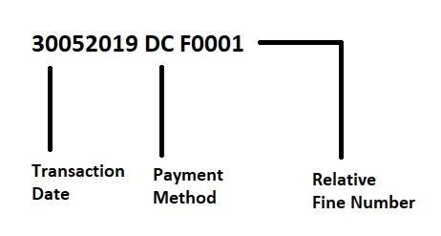
Codes
Payment (payment_no, amount, payment_method, payment_date, account_no*, report_no*)
Type of Codes: Derivation Codes
Transaction Date | Payment Method | Relative Fine Number
DDMMYY | C- Cash DC- Debit Card CC- Credit Card | The fine number which the payment is linked to

Slide 9
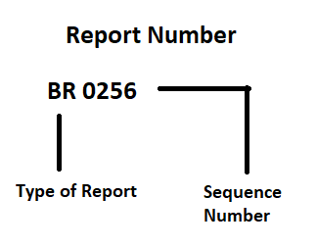
Codes
Report (report_no, date_created)
Type of Codes: Significant Alphabetic Codes
Type of Report | Sequence Number
BR- Book Report PR- Payment Report | The number of reports made. There will be 2 report with a same sequence number which is book report and payment report. Reports with same sequence number are made in the same day.

Slide 10
Table Design
Account Table
Field | Data Type | Remark | Format
account_no | varchar(6) | Primary Key | -
first_name | varchar(6) | - | -
last_name | varchar(20) | - | -
email | varchar(30) | - | -
password | varchar(16) | - | -
identity | varchar (16) | - | -
date_Joined | date | - | DD/MM/YYYY
fine_due | number (6,2) | - | RM 9,999.99

Slide 11
Table Design
Book Reservation Table
Field | Data Type | Remark | Format
reserve_no | varchar(5) | Primary Key | -
reserve_date | date | - | DD/MM/YYYY
book_id | varchar(9) | Foreign Key | Reference Loan Table
account_no | varchar(6) | Foreign Key | Reference Account Table
report_no | varchar(6) | Foreign Key | Reference Report Table

Slide 12
Table Design
Loan Table
Field | Data Type | Remark | Format or Reference
reserve_no | varchar(5) | Primary Key & Foreign Key | Reference Book Reservation Table
book_id | varchar(9) | Primary Key & Foreign Key | Reference Book Table
collection_date | date | - | DD/MM/YYYY
return_date | date | - | DD/MM/YYYY

Slide 13
Table Design
Book Table
Field | Data Type | Remark | Format
book_id | varchar(9) | Primary Key | -
book_title | varchar (50) | - | -
language | varchar (20) | - | -
author | varchar (50) | - | -
publisher | varchar (50) | - | -
isbn | varchar (13) | - | -
publish_year | number (4) | - | -

Slide 14
Table Design
Fine Table
Field | Data Type | Remark | Format
fine_no | varchar(5) | Primary Key | -
day_count | number (6) | - | -
fine_amount | number (6,2) | - | RM 999,999.99
payment_status | char(1) | -
account_no | varchar(6) | Foreign Key | Reference Account Table

Slide 15
Table Design
Payment Table
Field | Data Type | Remark | Format
payment_no | varchar(5) | Primary Key | -
amount | number (6,2) | - | RM 999,999.99
payment_method | char(2) | - | -
payment_date | date | - | DD/MM/YYYY
report_no | varchar(6) | Foreign Key | Reference Report Table
account_no | varchar(6) | Foreign Key | Reference Account Table

Slide 16
Table Design
Report Table
Field | Data Type | Remark | Format
report_no | varchar(6) | Primary Key | -
date_created | date | - | DD/MM/YYYY

Slide 17
Data Records
Account
account_no | first_name | last_name | email | password | identity | date_Joined | fine_due
000001 | Somerset | Leeson | sleeson0@cargocollective.com | 48CurL | 271102-79-9932 | 18-FEB-18 | $0.00
000002 | Emmott | Jobb | ejobb1@discovery.com | jO4sZZxha5U | 700223-25-1841 | 11-MAR-18 | $0.00
000003 | Loise | Poor | lpoor2@histats.com | GzjxDrECFru | 340724-21-8936 | 10-APR-18 | $0.00
000004 | Sal | Soigoux | ssoigoux3@alibaba.com | lre3e7Eoqvb | 221123-41-9313 | 10-APR-18 | $2.00
000005 | Zorah | Surphliss | zsurphliss4@pinterest.com | ZLjsE1 | 459066860 | 06-MAY-18 | $3.00
000006 | Ashli | Chown | achown5@123-reg.co.uk | yZMnw805 | 501006-30-9106 | 22-MAY-18 | $0.00
000007 | Ernest | Bru | ebru6@imdb.com | FKzMp9VGQ | 617392043 | 05-JUN-18 | $8.00
000008 | Nat | Fuge | nfuge7@blinklist.com | WLC8eV | 380224-05-0546 | 07-JUL-18 | $0.00
000009 | Andre | Masters | amasters0@1und1.de | cBJ6ov | 800190-10-1234 | 08-JUL-18 | $0.00
000010 | Tori | Krout | tkrouut1@trellian.com | sd9tKmGt | 811190-05-1546 | 09-JUL-18 | $0.00

Slide 18
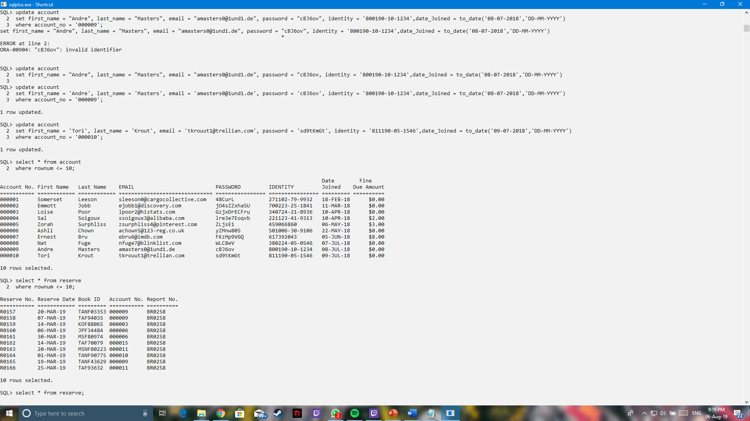
Data Records
SQL Result from Account Table

Slide 19
Data Records
Reserve
reserve_no | reserve_date | book_id | account_no | report_no
R0157 | 20-MAR-19 | TANF03353 | 000009 | BR0258
R0158 | 07-MAR-19 | TAF94035 | 000009 | BR0258
R0159 | 14-MAR-19 | KOF88065 | 000003 | BR0258
R0160 | 06-MAR-19 | JPF34484 | 000006 | BR0258
R0161 | 30-MAR-19 | MSF80974 | 000006 | BR0258
R0162 | 14-MAR-19 | TAF70079 | 000015 | BR0258
R0163 | 20-MAR-19 | MSNF80223 | 000011 | BR0258
R0164 | 01-MAR-19 | TANF90775 | 000010 | BR0258
R0165 | 19-MAR-19 | TANF43629 | 000009 | BR0258
R0166 | 25-MAR-19 | TAF93632 | 000011 | BR0258

Slide 20
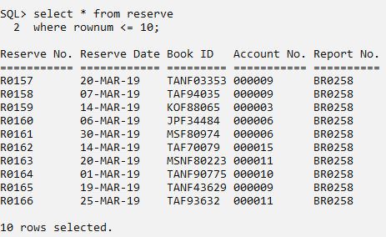
Data Records
SQL Result from Reserve Table

Slide 21
Data Records
Loan
reserve_no | book_id | collection_date | return_date
R0184 | TANF1014 | 10-MAY-19 | 10-JUN-19
R0185 | TANF51506 | 18-MAY-19 | 18-JUN-19
R0186 | TANF92983 | 06-MAY-19 | 06-JUN-19
R0187 | TAF57315 | 17-MAY-19 | 17-JUN-19
R0188 | JPF80350 | 04-MAY-19 | 04-JUN-19
R0189 | MSF81988 | 24-MAY-19 | 24-JUN-19
R0190 | ESNF28767 | 27-MAY-19 | 27-JUN-19
R0191 | TAF96337 | 27-MAY-19 | 27-JUN-19
R0192 | JPF06092 | 09-MAY-19 | 09-JUN-19
R0193 | MSNF51633 | 22-MAY-19 | 22-JUN-19

Slide 22
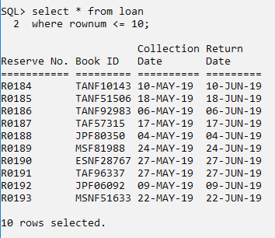
Data Records
SQL Result from Loan Table

Slide 23
Data Records
Book
book_id | book_title | language | author | publisher | isbn | publish_year
TANF85362 | Advanced Natural Gas Engineering | Tamil | Ciro Tomaselli | Gulf Publishing Company | 9781933762388 | 2010
KOF81137 | Coding and Decoding: Seismic Data | Korean | Jonas Detheridge | Pargamon | 9780080451596 | 2010
JPNF24921 | The Dusky Dolphin | Japanese | Salem Monkhouse | Academic Press | 9780123737236 | 2010
MSF72329 | Beer in Health and Disease Prevention | Malay | Minor Suttling | Academic Press | 9780123738912 | 2008
TANF26309 | Genetically Modified Plants | Tamil | Devlen Talton | Academic Press | 9780123741066 | 2009

Slide 24
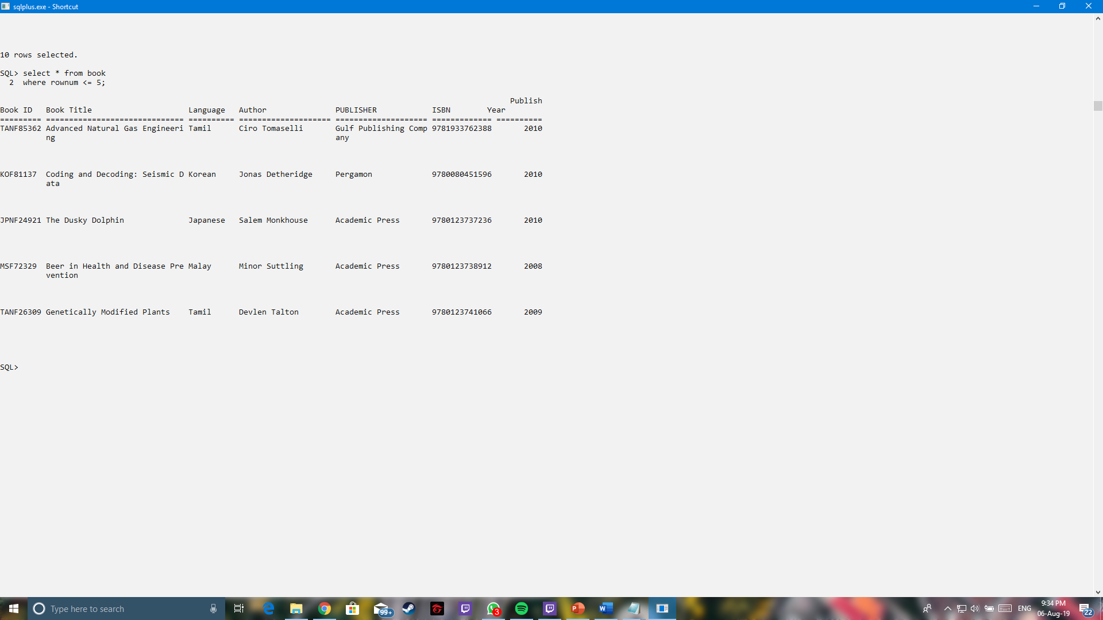
Data Records
SQL Result from Book Table

Slide 25
Data Records
Fine
fine_no | day_count | fine_amount | reserve_no | payment_status
F00001 | 1 | $1.00 | R0017 | n
F00002 | 1 | $1.00 | R0027 | n
F00003 | 4 | $4.00 | R0025 | p
F00004 | 3 | $3.00 | R0028 | p
F00005 | 4 | $4.00 | R0102 | p

Slide 26
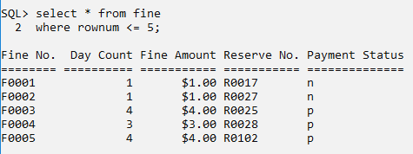
Data Records
SQL Result from Fine Table

Slide 27
Data Records
Payment
payment_no | amount | account_no | report_no | payment_method | payment_date
03032019CCF0003 | $4.00 | 000014 | PR0256 | CC | 03-MAR-19
26032019DCF0004 | $3.00 | 000015 | PR0256 | DC | 26-MAR-19
20042019DCF0008 | $4.00 | 000009 | PR0258 | DC | 20-APR-19
26042019CCF0009 | $1.00 | 000003 | PR0259 | CC | 26-APR-19
26042019CCF0010 | $3.00 | 000003 | PR0259 | CC | 26-APR-19

Slide 28
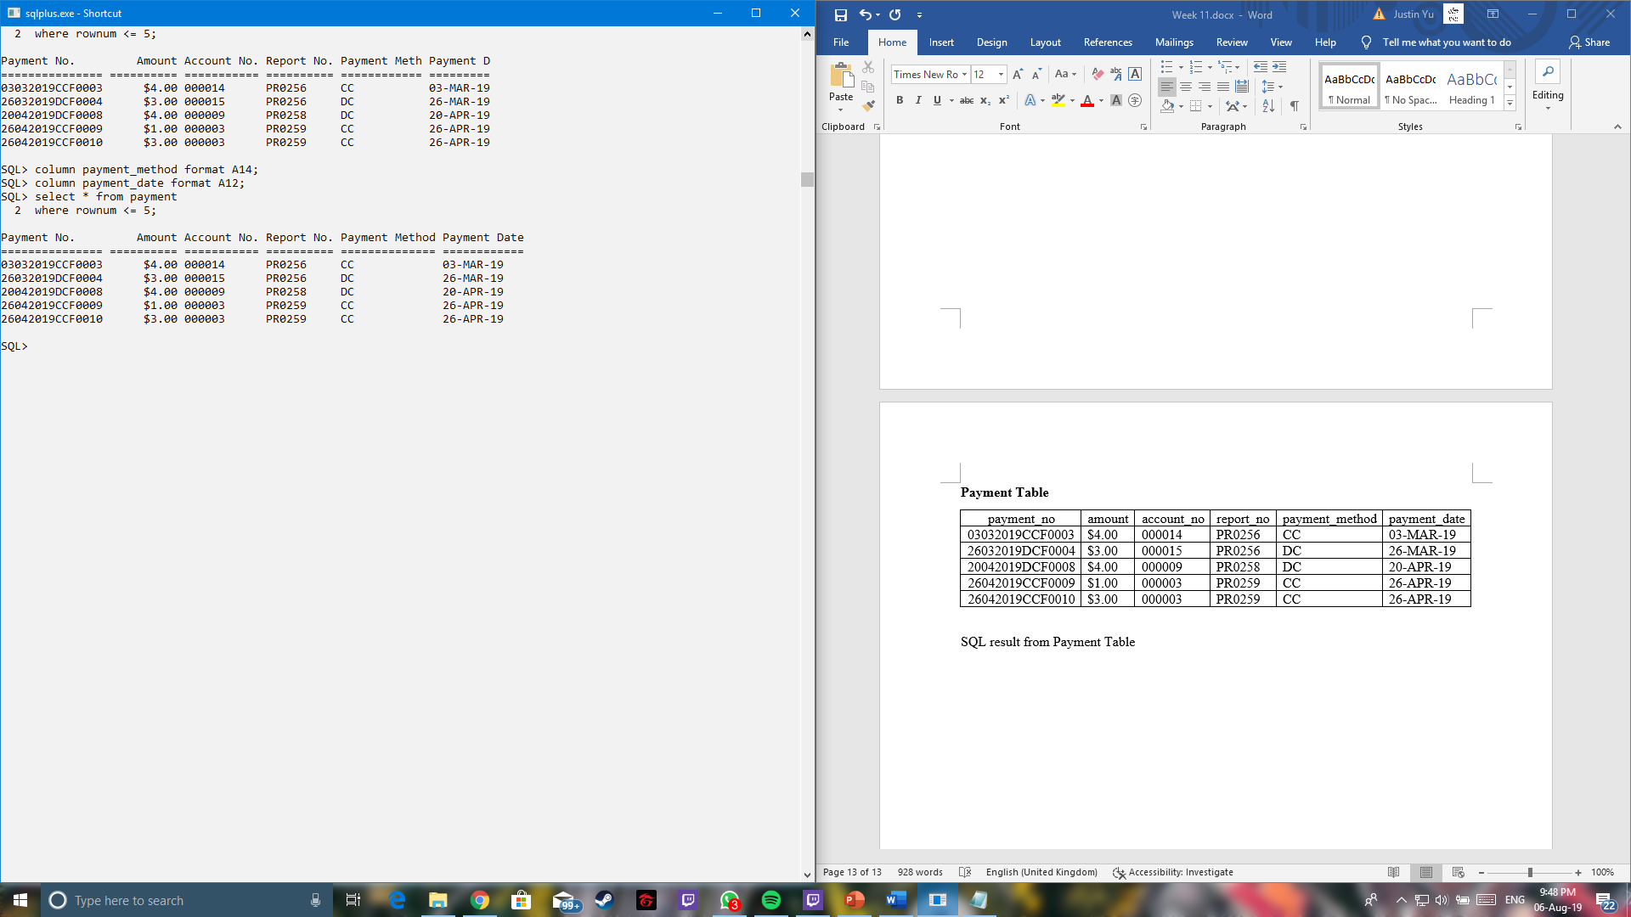
Data Records
SQL Result from Payment Table

Slide 29
Data Records
Report
report_no | date_created
BR0256 | 31-JAN-19
PR0256 | 31-JAN-19
BR0257 | 28-FEB-19
PR0257 | 28-FEB-19
BR0258 | 31-MAR-19

Slide 30
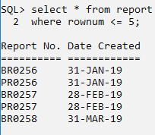
Data Records
SQL Result from Report Table

